Slide 1
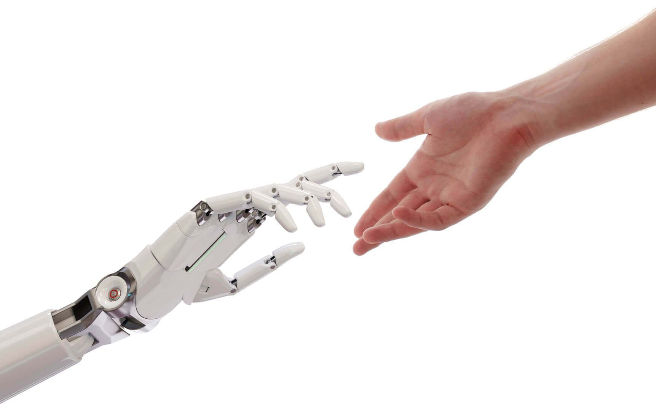
Human computer interaction
Faria Sajjad

Slide 2
What is HCI?
How Human interacts with Computer:
Not primarily the study of Human
Not primarily the study of Computer
The study of bridge between human and computer, which includes observation of interactions between people & computers.

Slide 3
What is HCI?
HCI Terms interchangeably used:
HCI (Human Computer Interaction)
CHI (Computer Human Interaction)
MMI (Man Machine Interaction)
HMI (Human Machine Interaction)
Interaction and Interface words: Interchangeably used
Interaction
Interface

Slide 4
What is HCI?
“ Human-computer interaction is a discipline concerned with the interactive design, evaluation and implementation of computing systems for human use and with the study of major phenomena surrounding them. ”
Humans interact with a computing system via a human-computer interface.
[ ACM SIGCHI Curricula for Human-Computer Interaction [Hewett et al., 2002, page 5] ]
Association for Computing Machinery- ACM
Special Interest Group on Computer Human Interaction- SIGCHI

Slide 5
User Interfaces (UIs)
What is HCI?
Part of application that allows users
to interact with computer
to carry out their task
HCI = design, prototyping, evaluation, & implementation of UIs

Slide 6
The Goal of HCI
Usability
People are trying to accomplish their tasks in life. (system independent)
Introduce a system, User Interface should maximize their ability.
task
person
system

Slide 7
A human-computer interface focuses in three main components (Rees et al. 2001):
1. The human
2. The computing system (machine)
3. The interaction

Slide 8
Communication Channels
System to human:
Human to system:
system,
world

Slide 9
Significance of HCI
HCI is critical in the development of software and hardware systems
We might have a powerful software application with many features but if the user is not able to operate it easily, he or she will discard it after few trials.

Slide 10
Why HCI?
In the past, computers were expensive & used by technical people only.
Now, computers are cheap and used by non-technical people (different backgrounds, needs, knowledge, skills)
Computer and software manufacturers have noticed the importance of making computers “user-friendly”: easy to use, save people time, etc.

Slide 11
Why DO we study HCI?
To develop products that are:
Easy to use
Easy to learn
Easy to remember
To design user-friendly computer systems
That support users to perform tasks easily and efficiently
To avoid unnecessary complexity in the design of computer systems

Slide 12
HCI and Academic Disciplines
Computer Science
Develop programming languages, system architectures, etc. of the computing systems
Engineering
Provide faster and cheaper equipment
Linguistics, Artificial Intelligence
Speech synthesis and recognition, natural language processing, etc.

Slide 13
HCI and Academic Disciplines
Psychology
Provide information about human mental capabilities (e.g., memory, decision making)
Ergonomics (Human Factors)
Provide information about human physical capabilities
Sociology
How people interact in groups

Slide 14
Computer Science
Psychology
Sociology
Design
Physiology
Philosophy
Linguistics
HCI
A.I.
Means of building better GUIs
User Interface Layout
Understanding users
User behavior
Memory
Groupware
Users physical capabilities
Language for commands
Error messages, labels etc.
Creating consistency
Notes:
Sociology: knowledge about human social structure and activity.
Cognitive science: study of nature of intelligence/ study of the thought process
Design: making of objects / systems (from construction to computer systems)
Computer vision: obtaining information from images, video sequences, obtaininig data from multiple cameras
Goals:
Improve the interaction between users and computers by making computers more usable and easy to use and responding to the users’ input.
HCI is more specifically related with computers while human factors is related with other objects/machines/designed artifacts as well.
In ergonomics we deal with the physical form of the industrial design of the user interface (and their use).

Slide 15
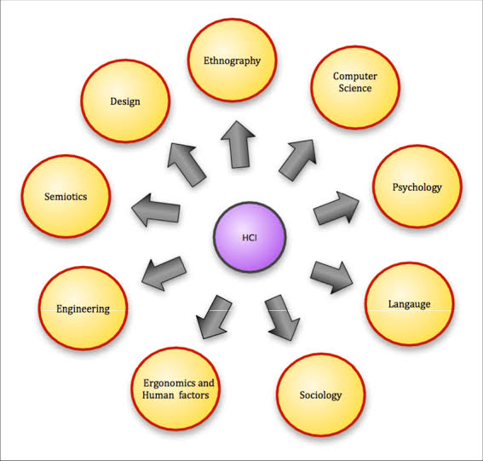
Semiotics-the study of signs and symbols and their use or interpretation.

Slide 16
People in HCI
Interactive / Interaction Designers
People involved in the design of all the interactive aspects of a product
Usability Engineers
People who focus on evaluating products using usability methods and principles
UI Designers
People experienced in user-centered design methodologies
UI Design Engineers
People who develop and model the end user experience
Web Designers
People who develop and create the visual design of websites, such as layouts & animations
Information Architects
People who come up with ideas of how to plan and structure interactive products
User Experience Designers
people who do all the above

Slide 17
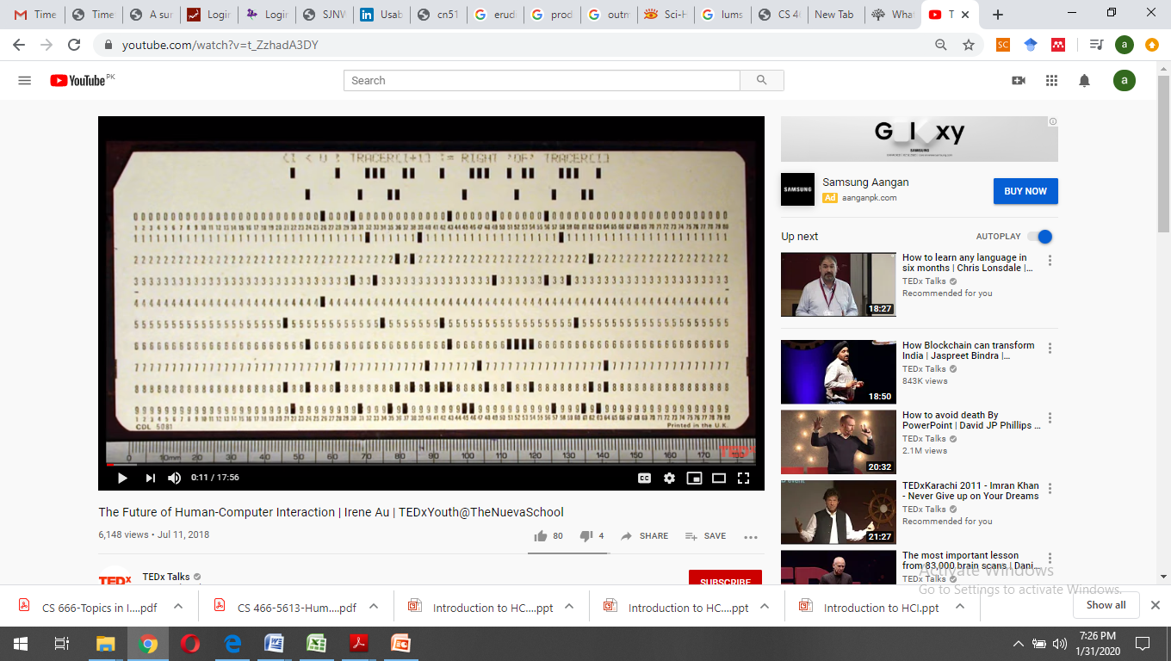
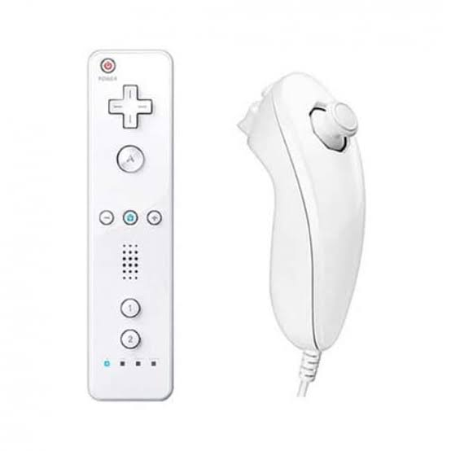
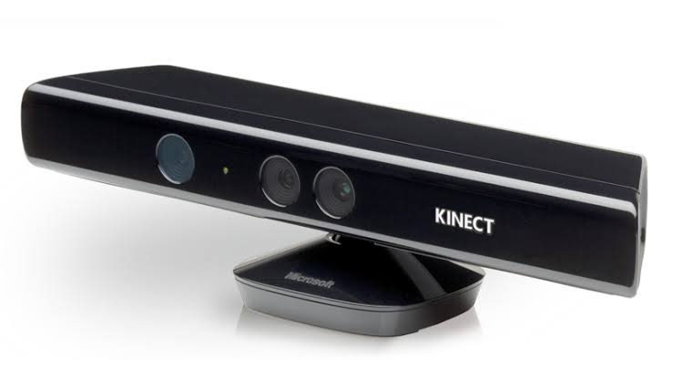
Examples of Devices use for interactions
Punch Cards
QWERTY keyboard.
Trackball
Video Game Joysticks
Mouse
Wii Remote
Microsoft Kinect
https://www.youtube.com/watch?v=t_ZzhadA3DY

Slide 18

XBOX

Slide 19
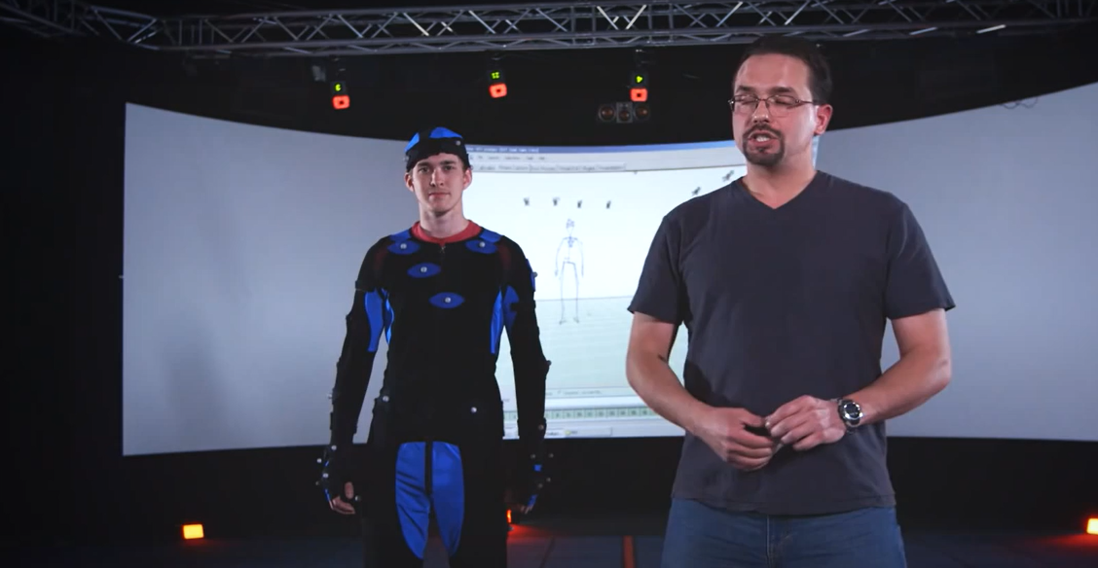
Motion Sensors
https://www.youtube.com/watch?v=fm-A1lknrxE

Slide 20
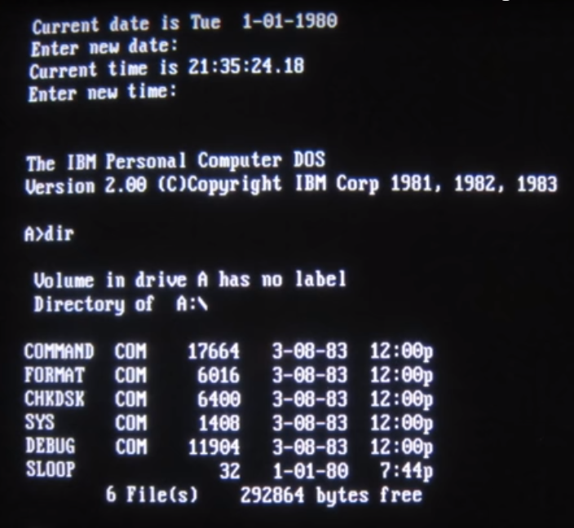
CLI –Command Line Interface

Slide 21
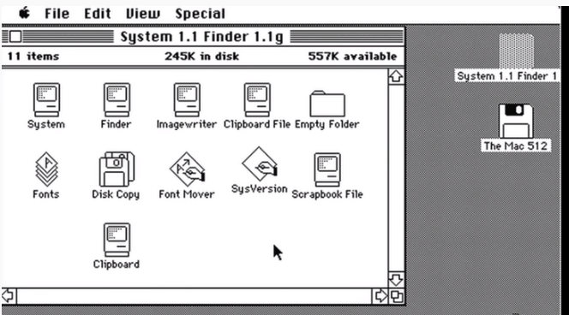
GUI-Graphical User Interface
It is successful interaction Design-
WIMP- windows-icons-menu-pointer

Slide 22
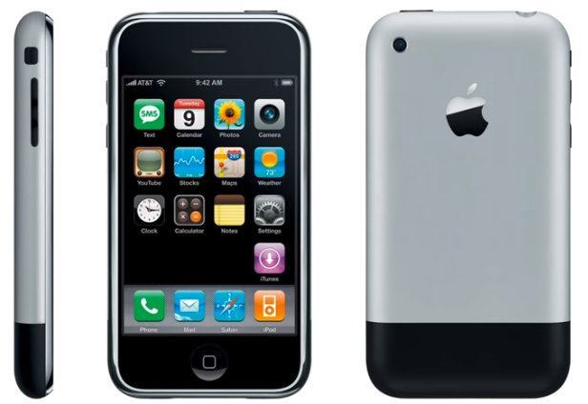
Mobile interface

Slide 23
NUI-Natural User Interface
Touchscreen interface
VUI- Voice user Interface- Siri Assistant on iPhone
BCI- Brain Computer Interface
Gesture based interface
motion-based video game- Nintendo Wii
Microsoft's Xbox Kinect
Virtual reality devices are NUIs, since they emulate a real world experience
robots are considered natural user interfaces since they respond to human motion and spoken commands
TUI-Tangible User Interface

Slide 24
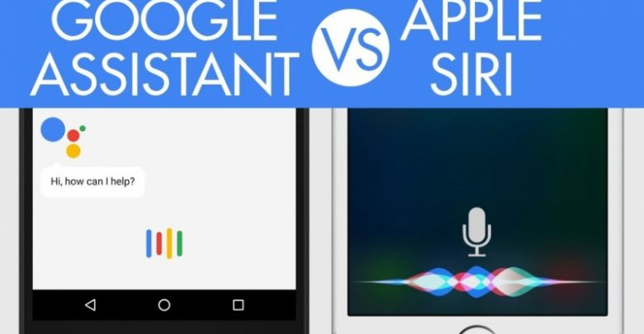
VUI-Voice User Interface
Apple Siri
Google Assistant

Slide 25
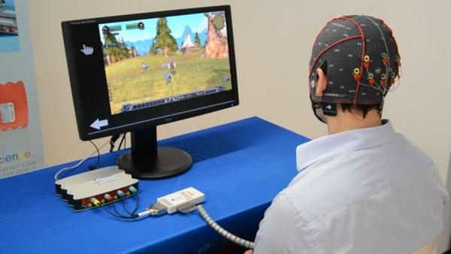
BCI- Brain Computer Interface
https://www.ted.com/talks/tan_le_a_headset_that_reads_your_brainwaves

Slide 26
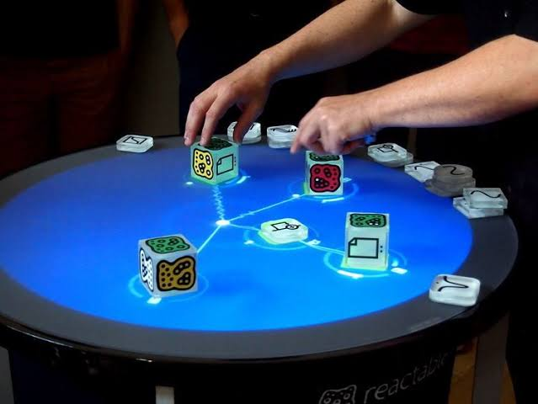
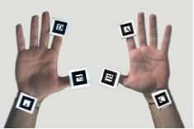
Tangible User Interface
https://video.search.yahoo.com/search/video;_ylt=AwrE19y_25Nb5Q0A9XxXNyoA;_ylu=X3oDMTB0N2Noc21lBGNvbG8DYmYxBHBvcwMxBHZ0aWQDBHNlYwNwaXZz?p=tangible+user+interface&fr2=piv-web&fr=mcafee#id=3&vid=9517576176954bef888ba793faf601dd&action=view

Slide 27
State of Art in HCI

Slide 28
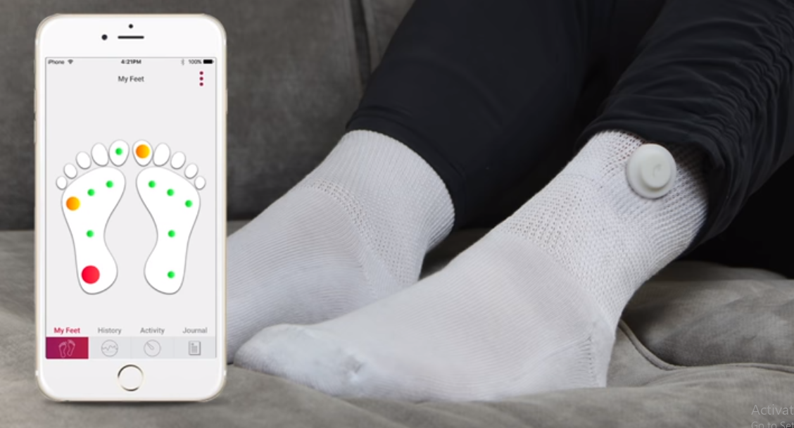
Sensors

Slide 29

Sensors + Big Data

Slide 30

NLP- Natural Language Processing+ AI- Artificial Intelligence
For Personality prediction and preferences extraction
For Census

Slide 31
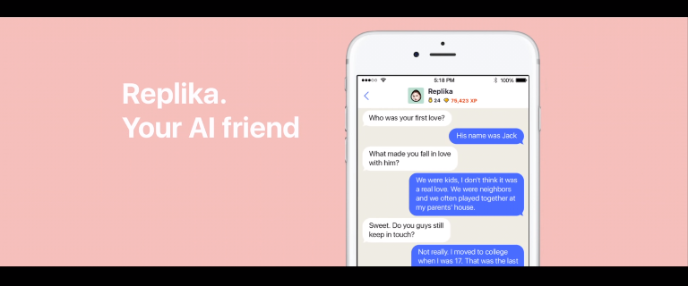
RepliKA APP

Slide 32
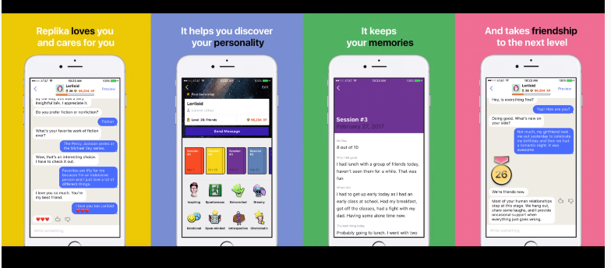
Version of RepliKa

Slide 33
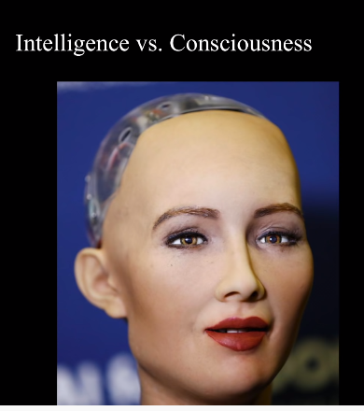
Robotics-
They can be friend, law enforcer, assistant.
Sophia robot

Slide 34
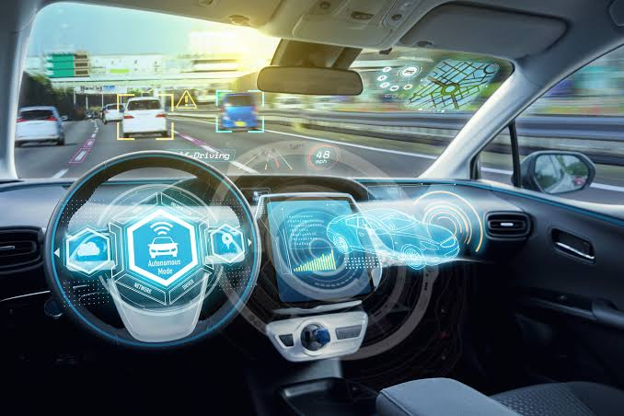
Autonomous Driving- Self Driving Cars

Slide 35
AR and VR
Augmented Reality -AR
Virtual Reality -VR

Slide 36


Augmented reality
Augmented reality, or AR, allows people to add digital elements into their actual environment. You’ve probably interacted with this technology already. Pokémon Go, social apps, and even the NFL-National Football League all use AR.
AR adds changes/ things to existing real world while VR changes the real world.
Augment app

Slide 37
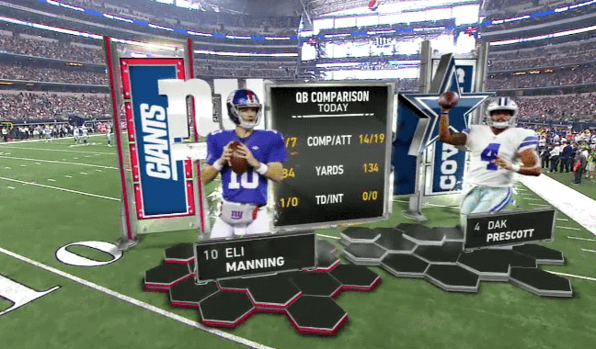
NFL-AR

Slide 38
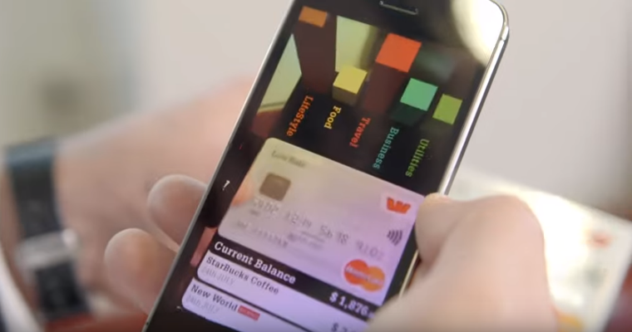
augmented reality
https://www.youtube.com/watch?v=1ir4h9c7NRY

Slide 39
VR replaces your world with a virtual one. Used in headset.
Or multi projected environment to generate realistic images. Facebook’s Oculus, Samsung’s gear and all VR’s Devices.

Slide 40
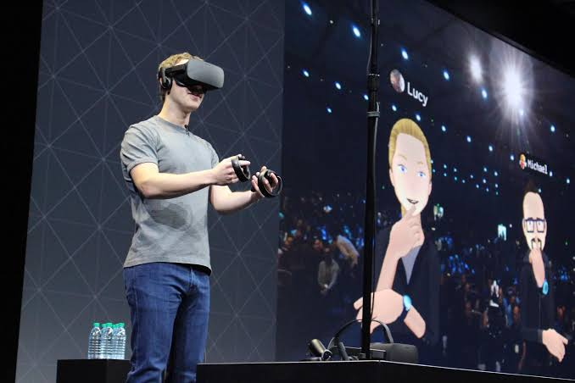
Facebook’s Oculus

Slide 41
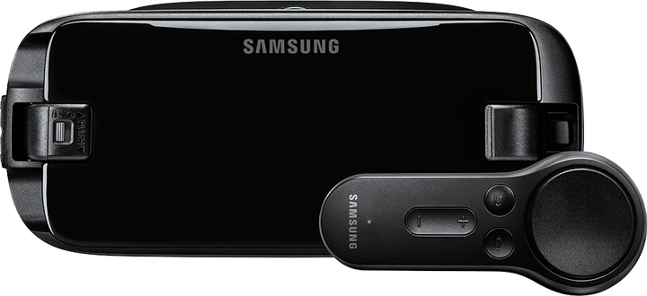
Samsung’s gear

Slide 42
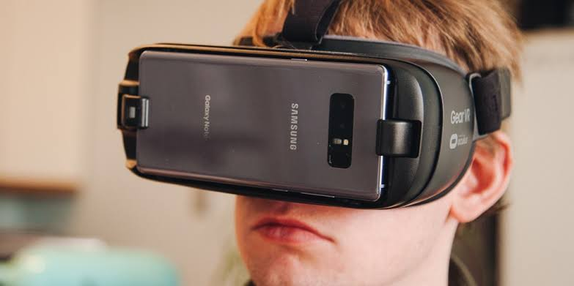
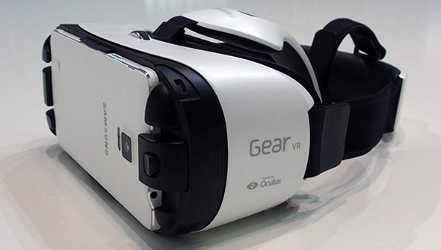
VR’s Devices

Slide 43
Benefits of HCI
Gaining market share
People intend to buy/use products with higher usability e.g., Google’s search engine has the largest market share because it is easy to use with higher efficiency
Improving productivity
Employees in a company perform their jobs in a faster manner. If the interaction with the product is easy and it is learnable then it will definitely increase employees productivity.

Slide 44
Lowering support costs
If the product is not usable, calls to customer support can be enormous
e.g., If a machine is difficult to use even after reading the instruction manual, many users will call the customer service and the cost per call can be over $100
Reducing development cost
Avoid implementing features users don’t want

Slide 45
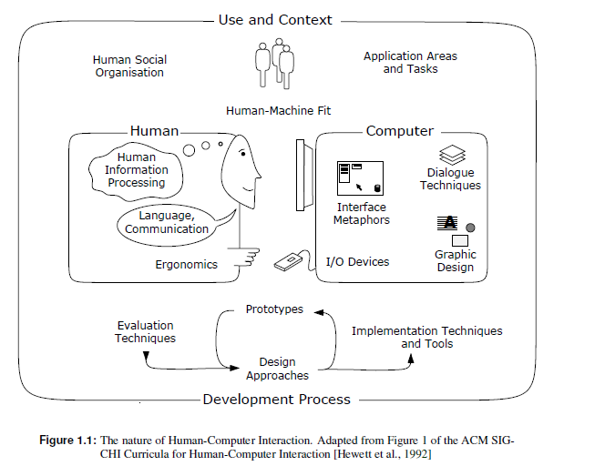
Nature of HCI

Slide 46
HCI Scope
Use & Context: Find application areas for computers
Human: Study psychological & physiological aspects e.g., study how a user learns to use a new product
Computer: Hardware & software offered e.g., input & output devices, speed, interaction styles, computer graphics
Development: Design, implementation & evaluation

Slide 47
User interface
User interface design is focused on the look and layout — how each element of the product will look, including buttons, text, images, checkboxes, and any visual interface elements people interact with.

Slide 48
UX
UX, which stands for user experience, is the process of researching, developing, and refining all aspects of a user’s interaction with a company’s products to ensure the company’s products is meeting the user’s needs. A UX designer must ensure people find value when they interact with a company’s products or services.
User experience is the overall experience a user has with a company’s products or services. Good and bad user experience is determined by how easy or difficult it is to interact with each element or aspect of a product or service.

Slide 49
UI
A UI designer’s responsibilities are more cosmetic than a UX designer’s -- a UI designer is responsible for the presentation of a product.
A UI designer is responsible for how everything on a page aligns in relation to each other. The visual elements you see on a page, such as buttons and icons, and the interactivity of a product, falls on the UI designer.

Slide 50
UX designers conduct market research and analysis to educate themselves about customer’s needs and desires before designing the functionality of a product.
UI designers keep themselves updated on graphic patterns and design trends that evolve as customers’ tastes and behavior changes.

Slide 51
Queries answer

Slide 52


